Slide 1
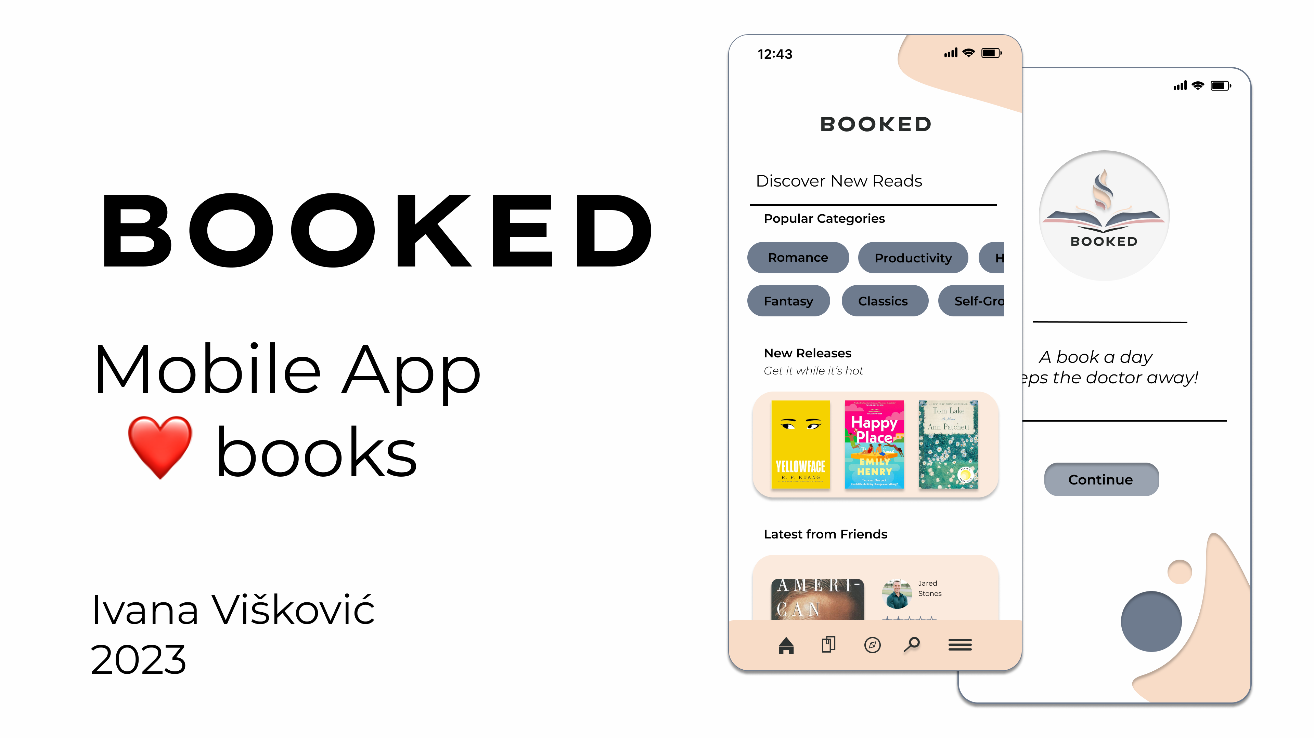
Mobile App books
DEPI graduation project

Slide 2

TABLE OF CONTENTS
01
02
Introduction
App Architecture
03
CONCLUSIONS

Slide 3

INTRODUCTION
Booked is a sleek and user-friendly mobile app designed to enhance your love for books. Whether you’re a casual reader or a literary enthusiast, this app has something for everyone

Slide 4

02
App Architecture

Slide 5
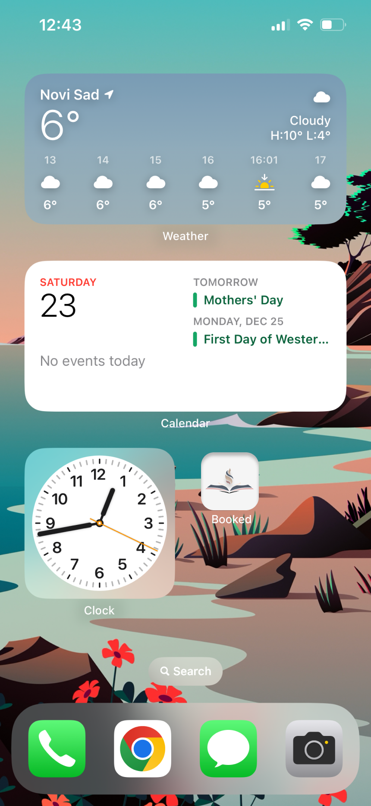
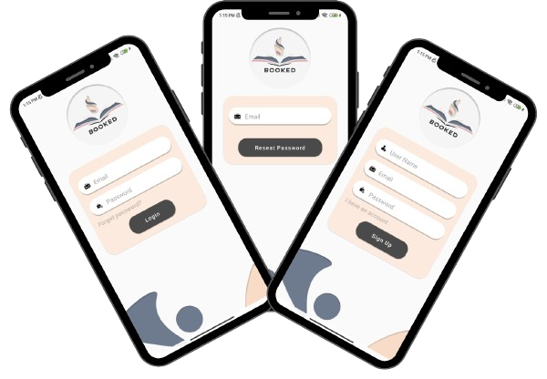
User Registration: Sign Up with Username, Email, and Password
How application look
Icon of the app

Slide 6
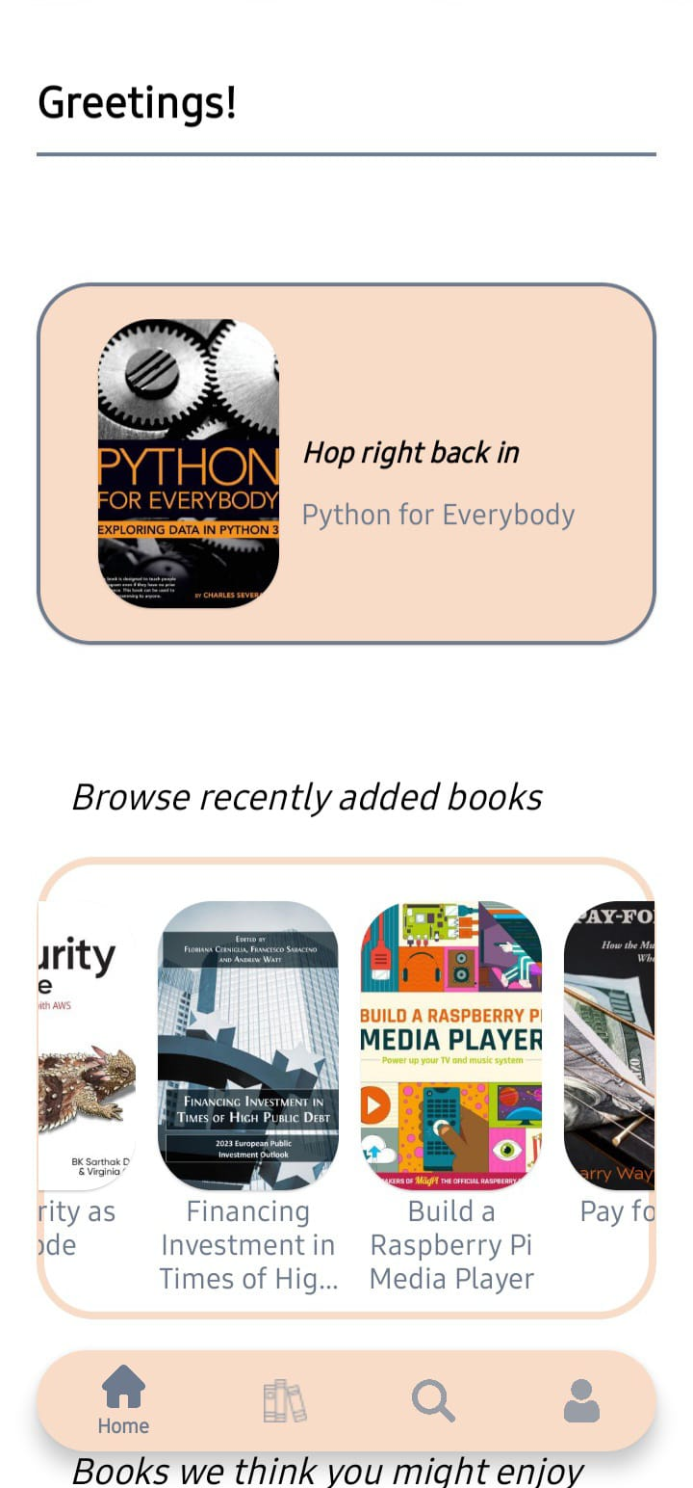
What in the App
1-Home Fragment
Last book read
In the app The recommended books are featured in an auto-scroll list that scrolls horizontally by itself . The user can click on a book to stop it

Slide 7
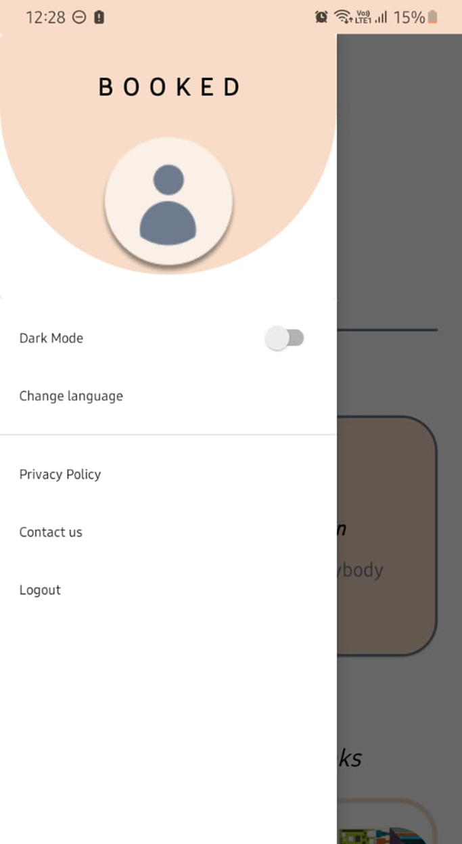
In home Fragment there is a navigation drawer it Contain:
1-Dark Mode
2-Language
3-Privace and policy
4-Contact us(you can call as If you have any problem(
5-Log out

Slide 8
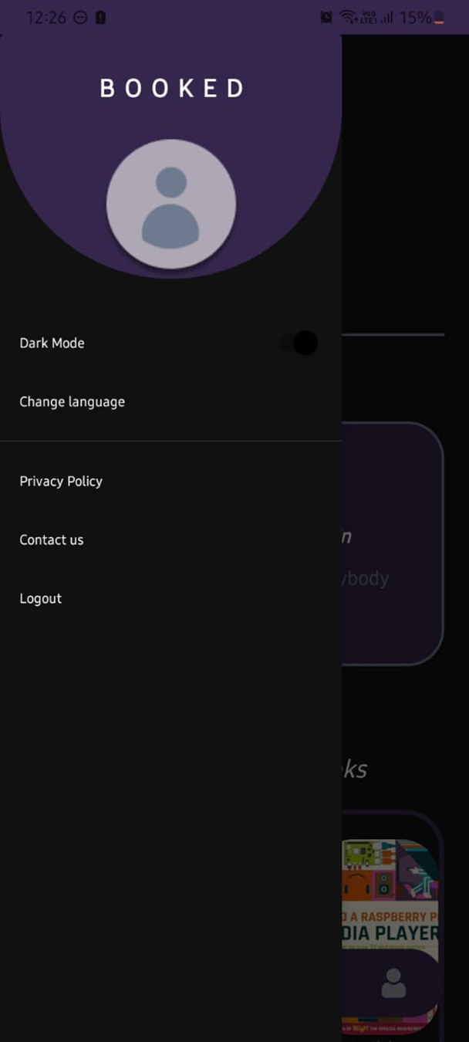
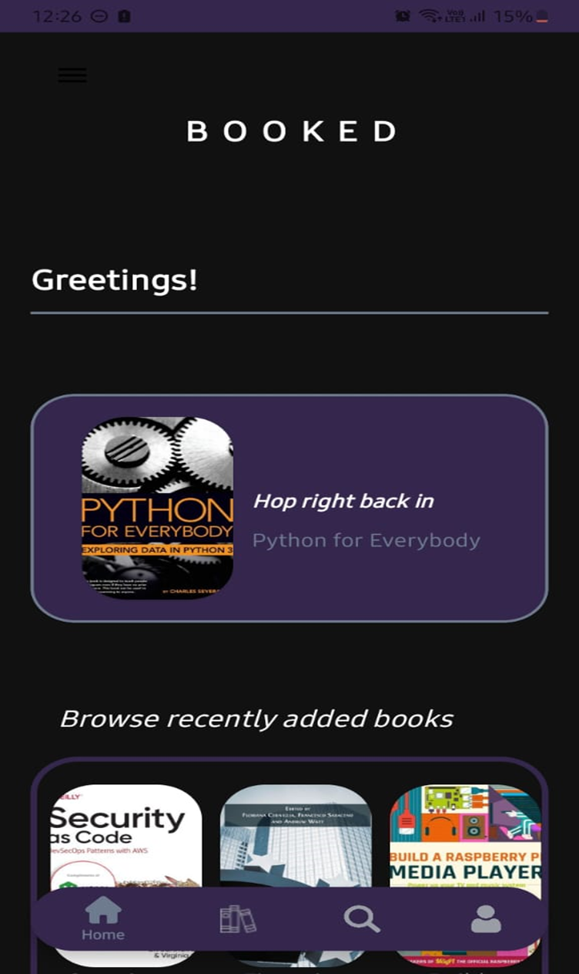
1-Dark mode
clicked

Slide 9
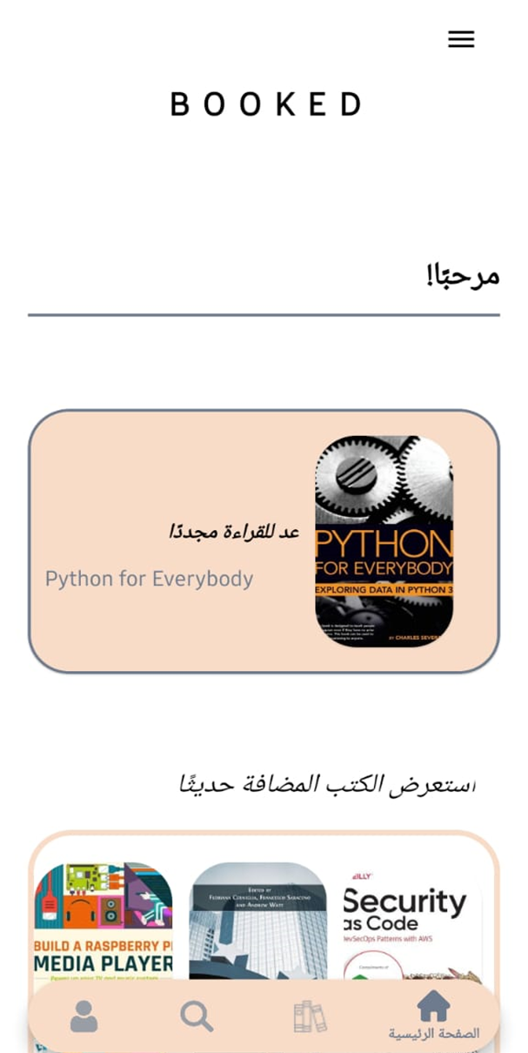
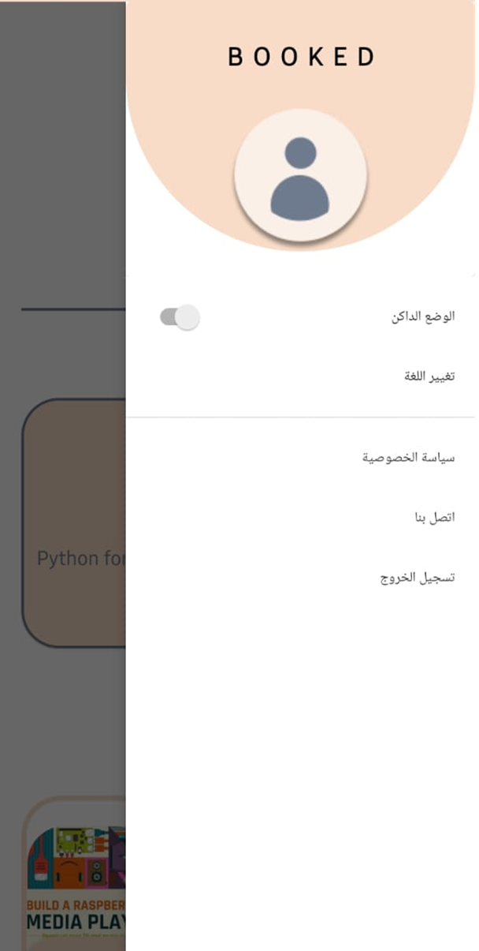
2-Language
You can change the language If you want

Slide 10
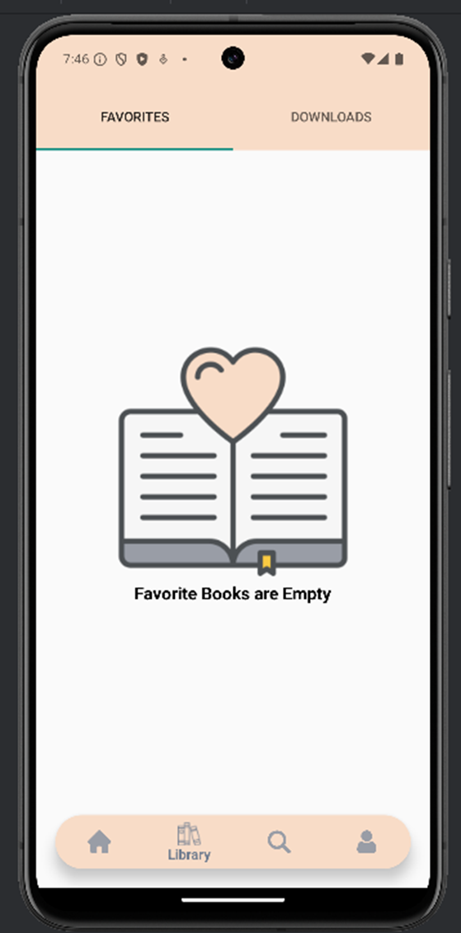
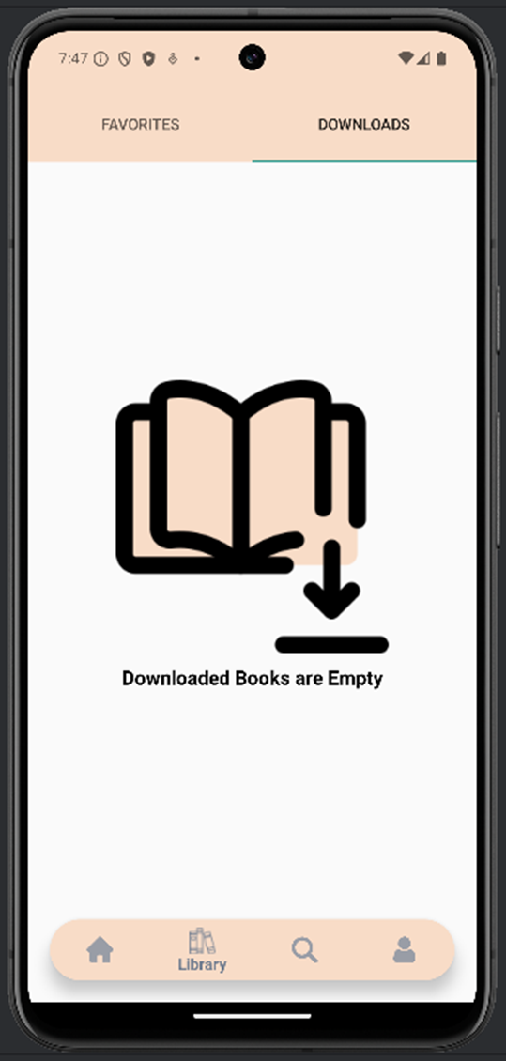
2-Library Fragment (Favorites & Downloads)

Slide 11
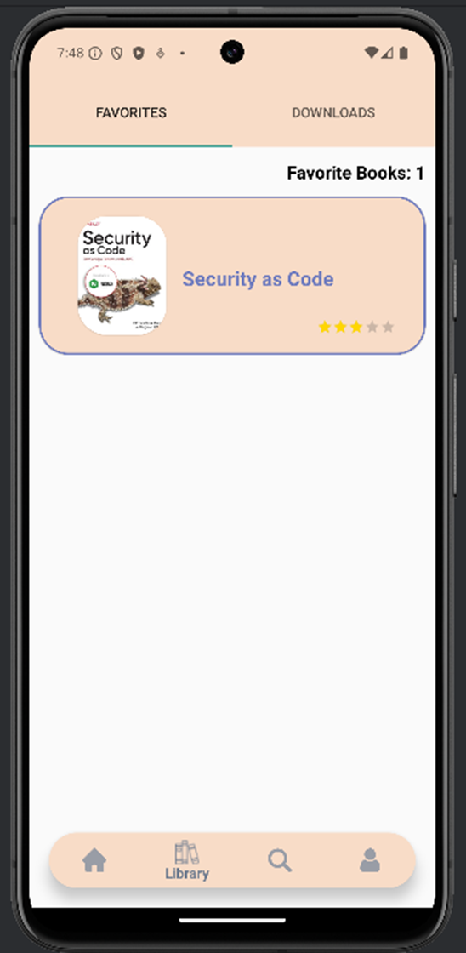
The Library Fragment allows users to manage their favorite and downloaded books in two distinct sections: Favorites and Downloads.

Slide 12
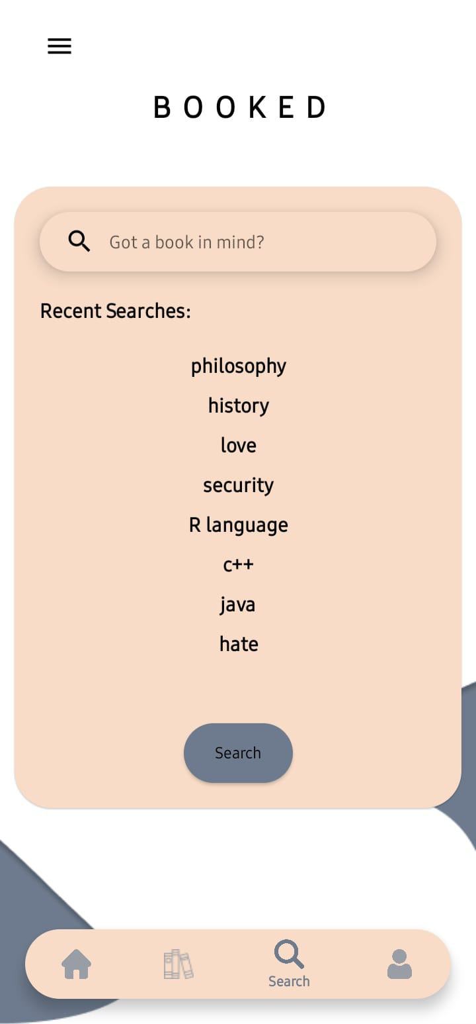
The Search screen enables the user to search for a book or a general term for which they wish to browse books related to, knowing that their search history is saved
3- Search Fragment

Slide 13
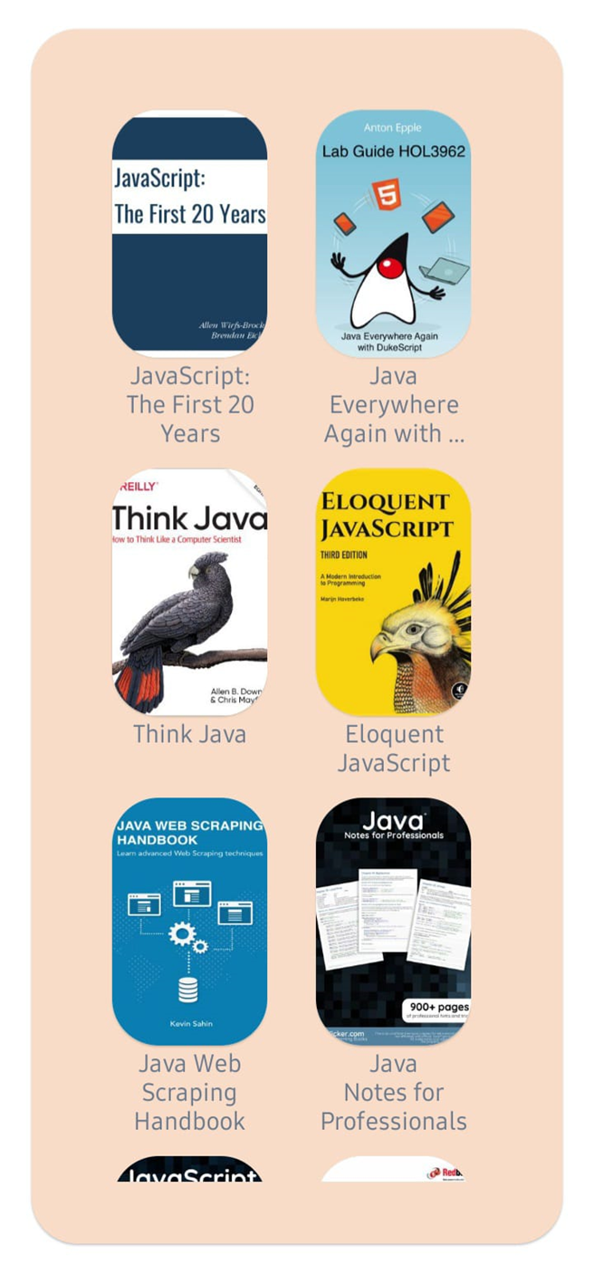
Result of search
Question
what would happen if you clicked on a book?

Slide 14
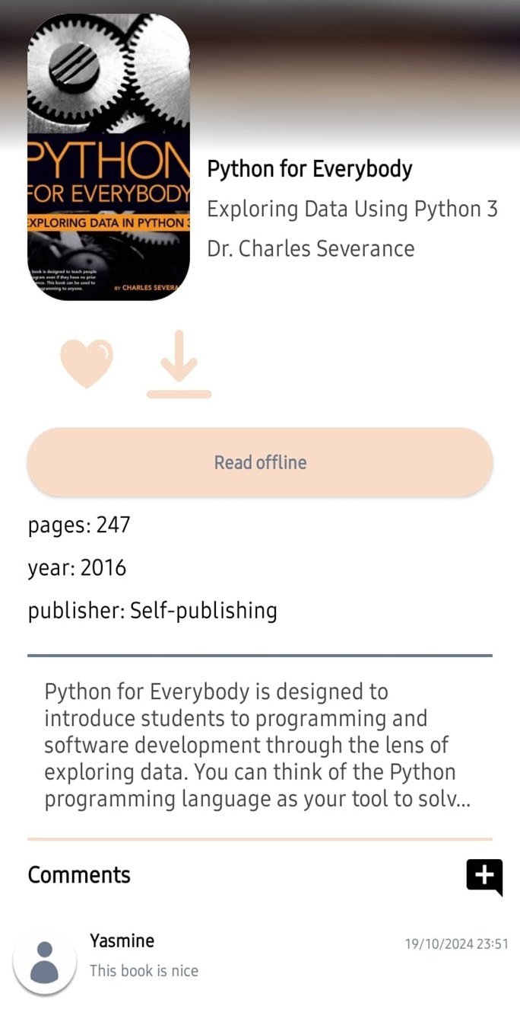
The details page feature multiple important functionalities
Answer
Download
Add to Favorites
Description
comment section

Slide 15
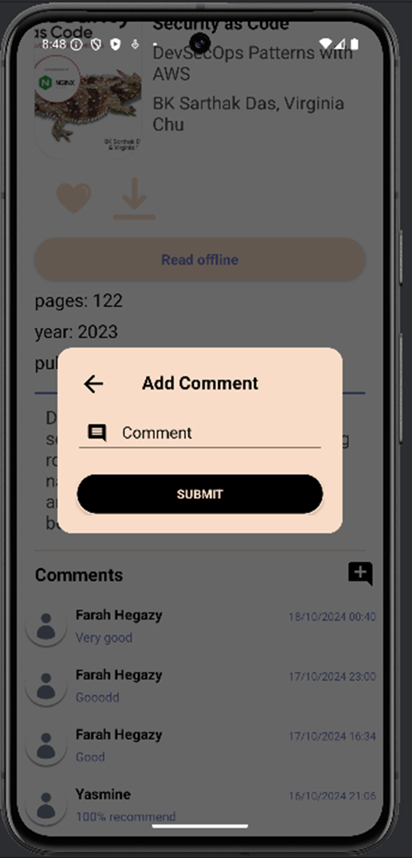
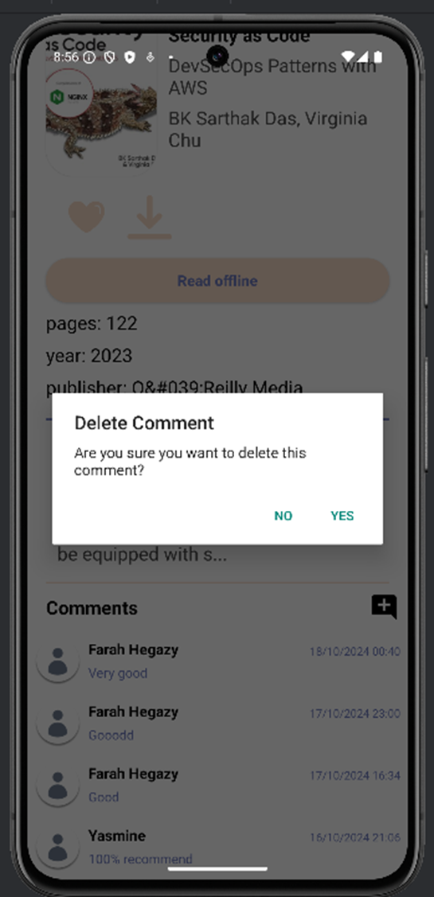
You can also
Add comment
Delete comment

Slide 16
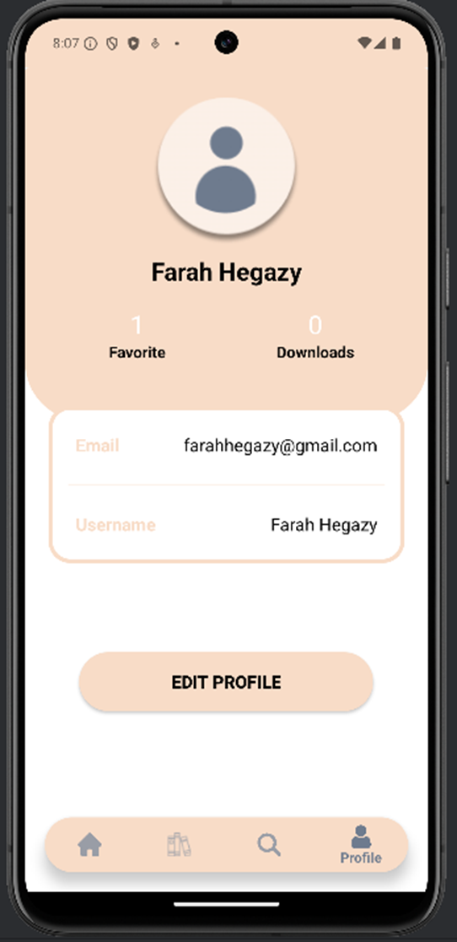
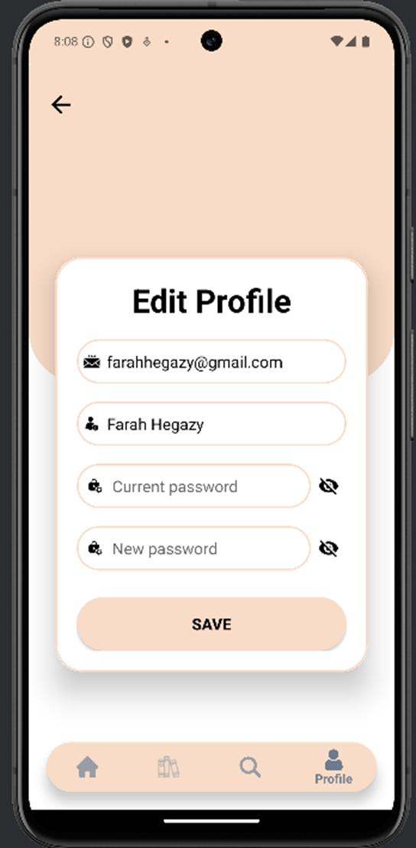
4-User Profile Fragment and Account Management
This screen includes:
Username and Email Address.
Favorites and Downloads
Edit Profile Button: when clicked on this button the user can make changes to their account information.

Slide 17


THANKS!
Team members:
Ahmed Adel Mohamed
Osman Saad Osman
Asmaa Hamdy Mahmoud
Farah Mohamed Ahmed
Yasmine Ali
Ahmed Adel Elshahat

